Slide 1
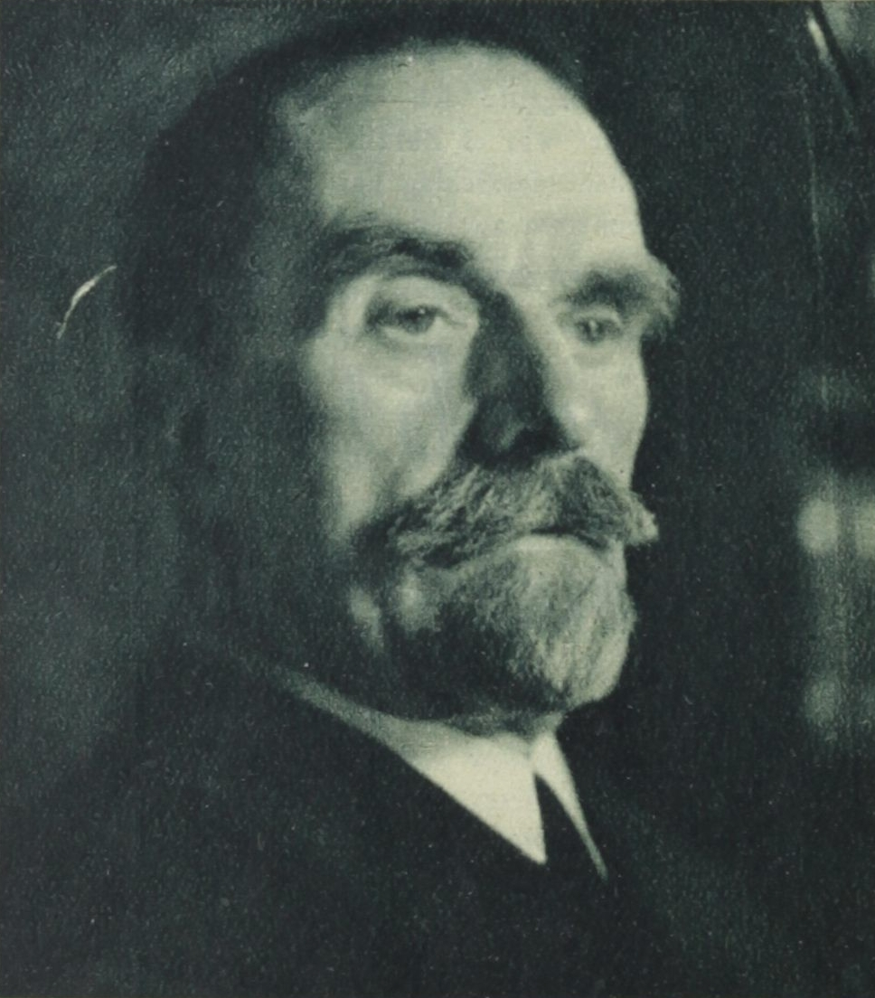
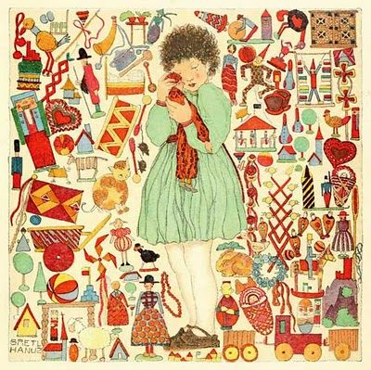
PUPPET CHARACTERS
For Art Education
Student Name: Steven M. Brentnall Semester/Year: Fall 2021 Character title: Franz Cizek
Art 590, History & Philosophy of Art Education; Fall 2021

Slide 2
CHARACTER TITLE: Franz Cizek
RELATIONSHIP OF PUPPET TO THE TOPIC: Franz Cizek is the pioneer of the Children’s Art movement in pedagogy.
TOPIC TITLE: Franz Cizek and Issues-Based Art Education
TOPIC DESCRIPTION:
SIGNIFICANT CONTRIBUTION OF THIS PERSON, MOVEMENT OR ART EDUCATION PRACTICE: Cizek was a facilitator for children’s creativity, often allowing them to work in his presence largely uninfluenced.
RELEVANT DATES: 1895-1946 (end of life)
IS HE/SHE/IT STILL IN EXISTENCE? While Cizek has long since passed away, it’s my belief that his influence carries on in popular culture and thus subtly influencing visual culture
YOUR THOUGHTS ABOUT THE RELEVANCE OF THIS TOPIC TODAY: It was only a matter of time that a figure like Franz Cizek would emerge from the era of post-Romanticism/pre-Modernism, as much of the zeitgeist of the day was set on reformation and re-examination.

Slide 3
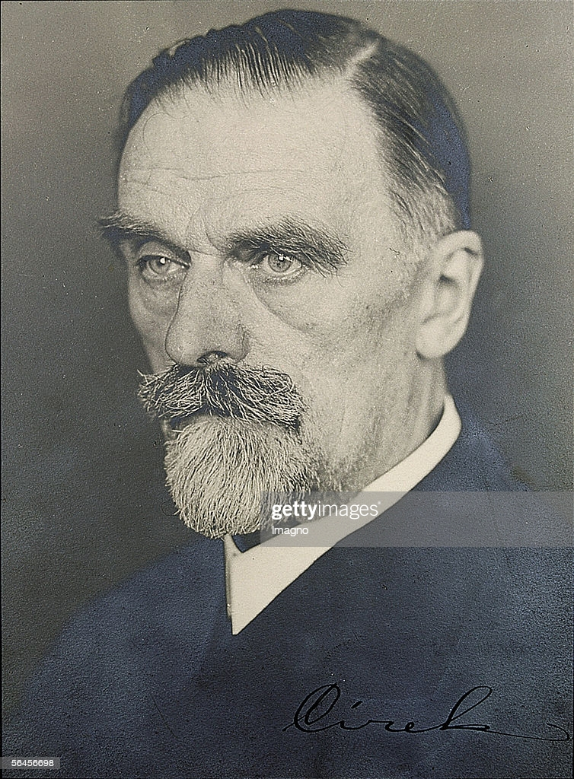
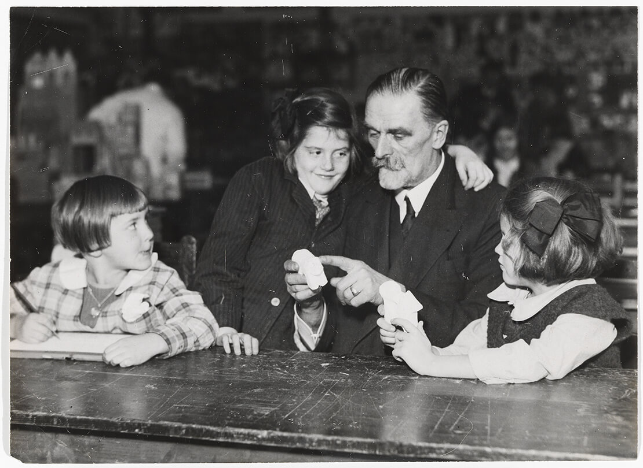
Franz Cizek’s methodology is characterized by a “noninterventionist teaching philosophy” (Efland, PP.199)
“Cizek gave art lessons to children and adolescents and used a pedagogic style that did not impose his or other artists' aesthetic sensibilities on his students. His supporters organized exhibitions of his students' work, and the work was praised for being supposedly uninfluenced by existing theories and true representations of children's experiences.” (Malvern, PP.1)

Slide 4
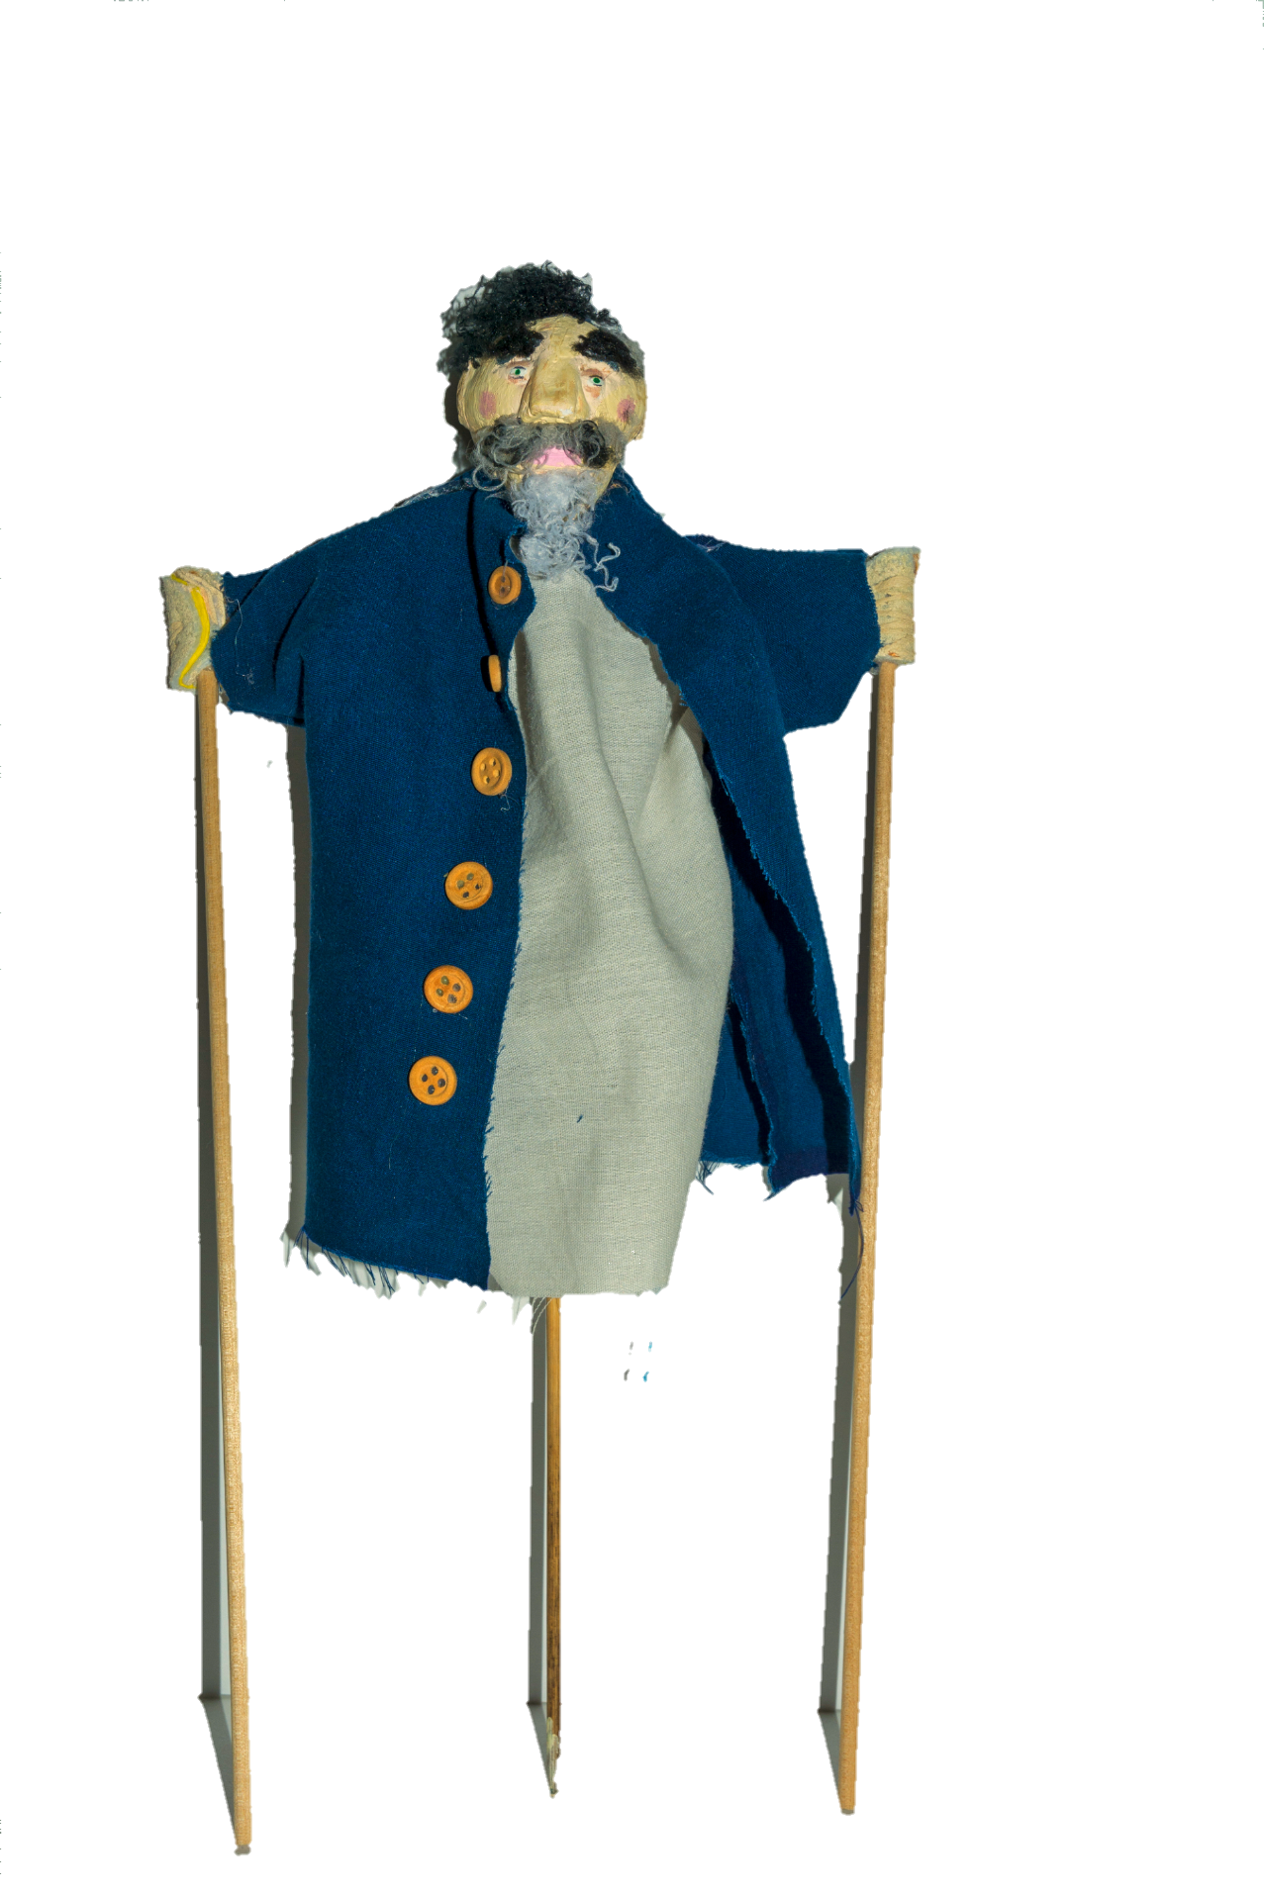
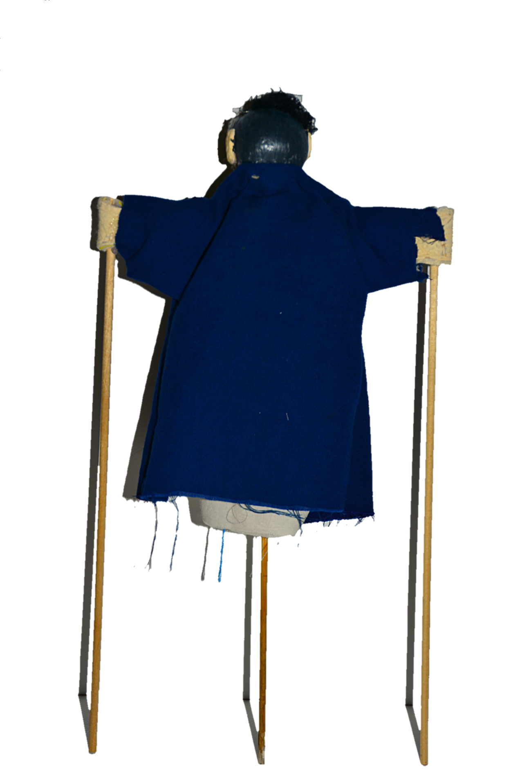
PHOTO I - FULL FRONTAL VIEW
PHOTO 2 - FULL BACK VIEW

Slide 5
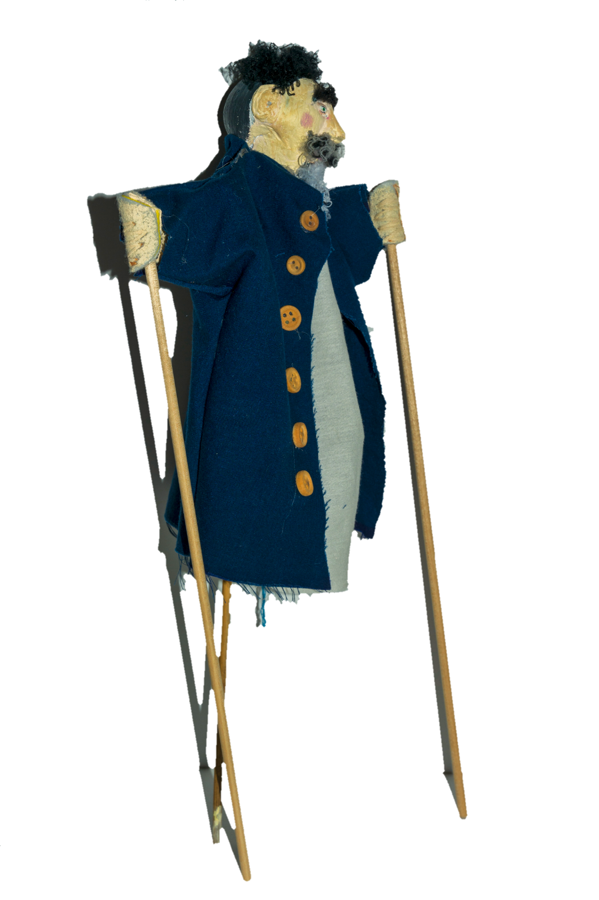
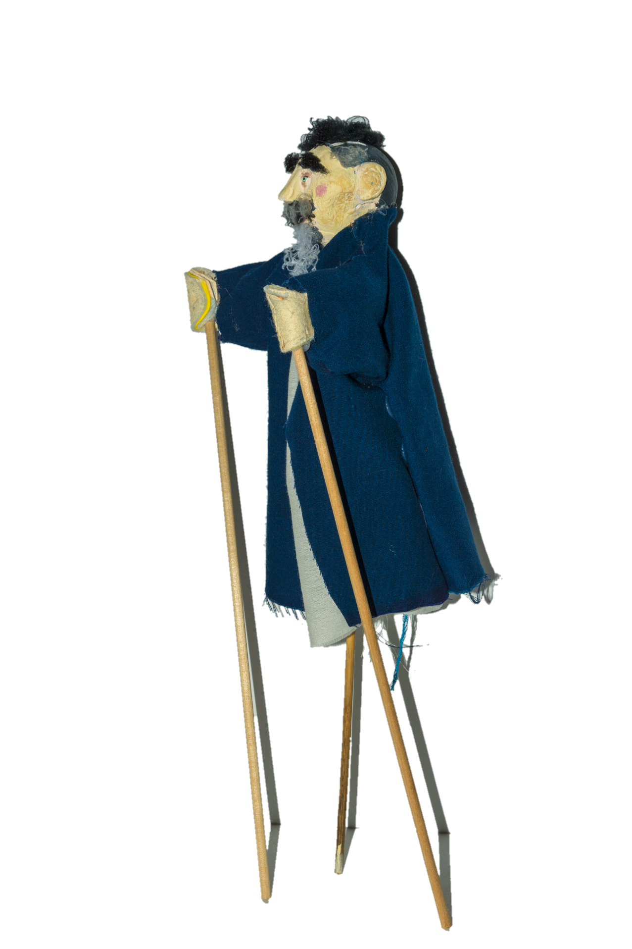
PHOTO 3 - FULL SIDE VIEW
PHOTO 4 - FULL OTHER SIDE VIEW

Slide 6
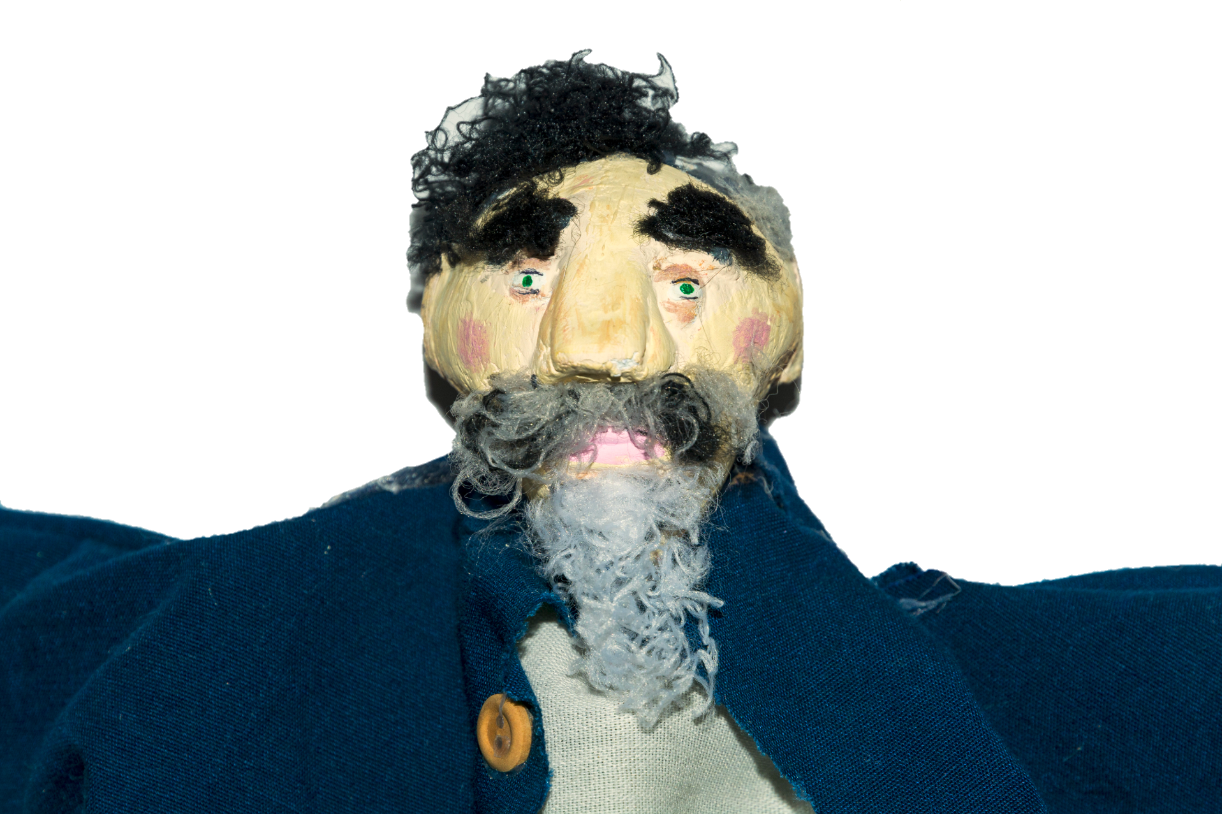
DETAIL (Closeup)

Slide 7
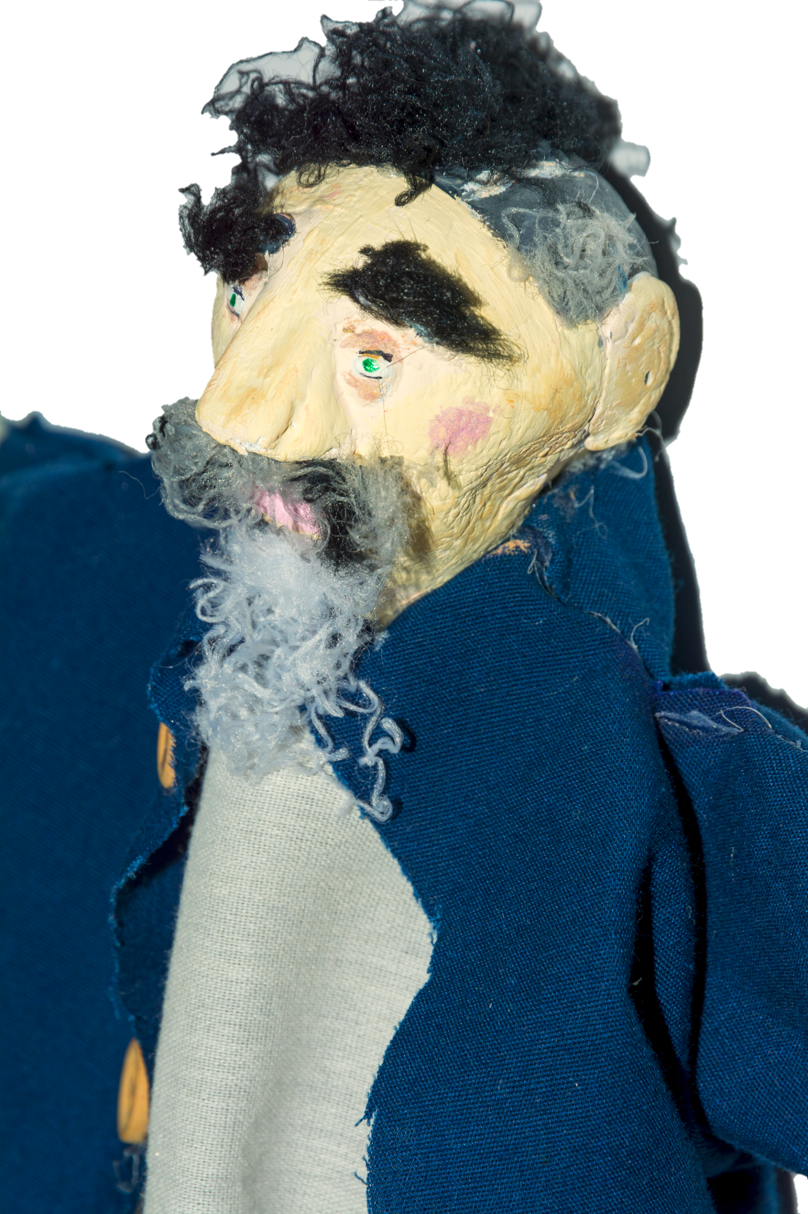
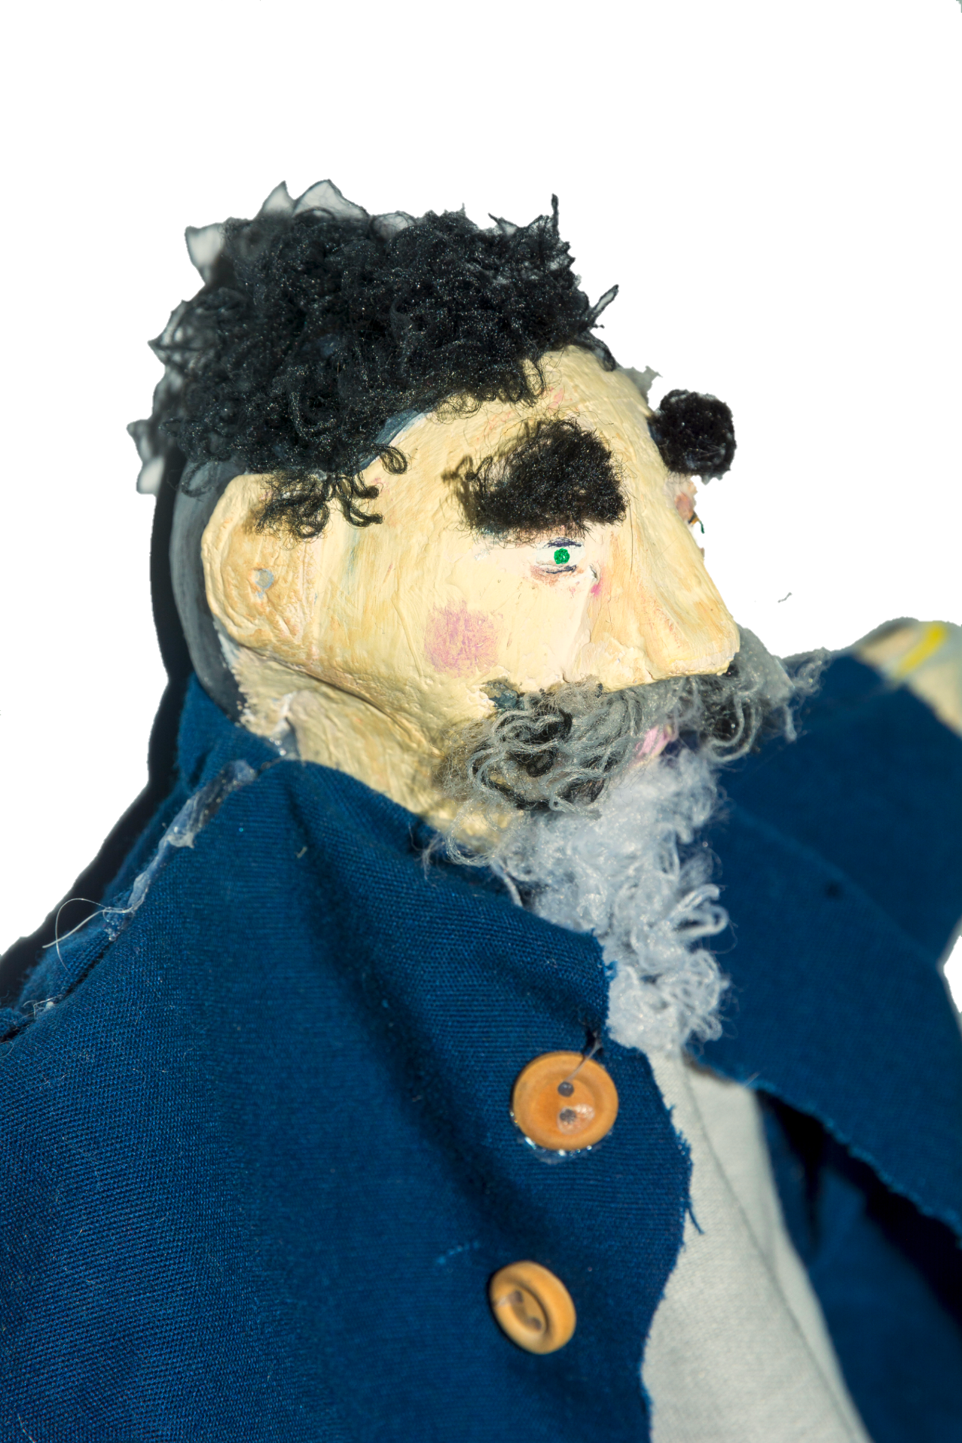
PHOTO 5 - DETAIL 1 (Closeup)
PHOTO 6 - DETAIL 2 (Closeup)

Slide 8
RESOURCE LIST
(FROM YOUR PAPER ,AND ANY ADDITIONAL SOURCES FOR PHOTOS)
Malvern, S. “Inventing ‘child Art’: Franz Cizek And Modernism.” The British Journal of Aesthetics, vol. 35, no. 3, Oxford University Press, 1995, pp. 262–72, doi:10.1093/bjaesthetics/35.3.262.
Efland, Arthur D. A History of Art Education: Intellectual and Social Currents in Teaching the Visual Arts. New York: Teachers College Press, 2008. Print.
All photos from Google Images.

Slide 9


